Slide 2
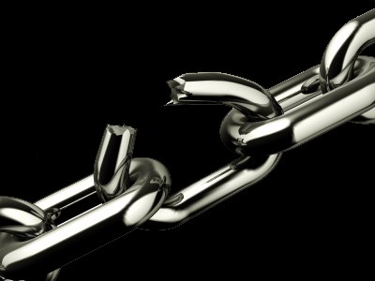
Convenient religion
No sacrifices
Practice self desires
Non-embarrassing faith; no strict morality
No cross

Slide 3
Are you a strong christian?
(1 Jn. 2: 15-17; Rom. 12: 1;
1 Peter 1: 15, 16; 2 Cor. 6: 14- 18).
Are you ready to do battle for the Lord and His cause?

Slide 4
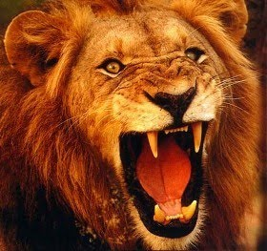
1 Pet. 5: 8, 9
Satan wants to destroy your soul by “devouring you.”

Slide 5
How can we defeat such a powerful adversary?
He is a cheat, liar, deceiver, manipulator, thief, and a murderer.

Slide 6
Eph. 6: 10-13
Christians are called upon to engage in spiritual warfare (2 Tim. 2: 3, 4). We are to “fight the good fight of faith”
Hebrews 3: 12, 13

Slide 8
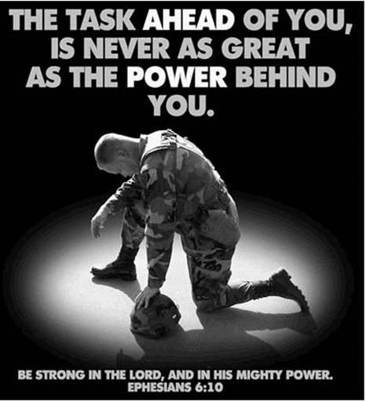
1 Jn. 4: 4

Slide 9
“For the night is far gone; the day is at hand. So then, let us cast off the works of darkness and put on the armor of light” (Rom. 13: 12).

Slide 10
Will you stand firm with Jesus (Eph. 6: 14ff)?
God provides the needed equipment; we need to be willing to use it.

Slide 15
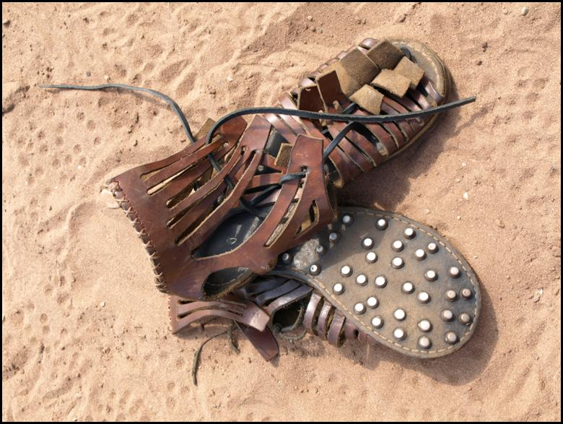
1 Pet. 3: 15

Slide 16
Heb. 12: 3

Slide 17
Hebrews 4: 12

Slide 18
Romans 10: 17
Heb.11: 6

Slide 19
Ephesians 6: 18, 19
Matthew 26: 41

Slide 20
THE DEVIL LOVES
Christians who refuse conflict.
Christians who are complacent.
The attitude – We’re all okay.
Christians who compromise.
Sunday only Christians.

Slide 21
2 Thes. 2: 15, 16
Rom. 1: 16

Slide 22
Do you study?
Do you worship regularly?
Do you pray without ceasing?
Do you have hope in Christ?
Do you hunger for righteousness?
Do you speak to others of Christ?
Do you defend the truth?

Slide 23
Are you fully devoted to Jesus?
Are you standing firm?
Are you prepared for battle?
Rom. 12: 2; 1 Cor. 6: 19, 20

Slide 25
1 Peter 2: 9-12 -- My power is in Christ!!!
My duty is to be strong in Him (Eph. 6: 10).
To remain weak and without the knowledge that empowers us is sinful
(2 Peter 3: 18).

Slide 26
Let us be determined to stand
Strong in trust.
Strong in knowledge.
Strong in faith and love.
Strong in hope.
Strong in courage.

